Slide 1
MERN Stack Bootcamp · Week 2 · Day 6
JavaScript Modules & Tooling
ES Modules · npm · Vite
From <script> tags to a modern dev workflow
Instructor
Duration
Abid Ali
90 minutes (lecture)
Prereq: comfortable JS · arrays/objects · browser DevTools

Slide 2
Day 6 — JavaScript Modules & Tooling: ES Modules, npm, Vite
Week 2 · Day 6
Agenda (90 min)
• 1. Why modules? The global-scope disaster (7 min)
• 2. A short history: IIFE → CommonJS → ES Modules (5 min)
• 3. export — named, default, re-export (10 min)
• 4. import — named, default, namespace, rename (10 min)
• 5. Module resolution & quirks (5 min)
• 6. npm — package.json, lockfile, semver (10 min)
• 7. npm scripts & installing packages (8 min)
• 8. Bundlers — why we still need them (5 min)
• 9. Vite — dev server, HMR, build (15 min)
• 10. Project structure & tour of a real app (10 min)
• 11. Pitfalls, cheat-sheet, next steps (5 min)
By the end of today you will scaffold a real Vite project, split it into modules, install npm packages, and build it for production.
MERN Stack Bootcamp · Instructor: Abid Ali
2 / 25

Slide 3
Day 6 — JavaScript Modules & Tooling: ES Modules, npm, Vite
Week 2 · Day 6
Where we are in the journey
• Week 1 — the engine, the event loop, the DOM.
• Week 2 Day 3–5 — async, Promises, array methods.
• So far: every file loaded via <script> into one big global soup.
• Today — we finally put our code into real, isolated files and plug into the modern JS ecosystem.
React, Express, and every tutorial you will read from now on assumes you know ES Modules + npm + Vite. Today fills that gap.
MERN Stack Bootcamp · Instructor: Abid Ali
3 / 25

Slide 4
Day 6 — JavaScript Modules & Tooling: ES Modules, npm, Vite
Week 2 · Day 6
By the end of this lecture, you will be able to…
• Explain why a MODULE SYSTEM is needed in any non-trivial JS app.
• Write correct export / import statements (named, default, namespace, renamed, re-exported).
• Read package.json and package-lock.json — and understand semver ranges like ^ and ~.
• Install, update and remove packages with npm, and add npm scripts.
• Scaffold a Vite project, run the dev server with HMR, and produce a production build.
• Split a small app into clean modules with a single entry file.
MERN Stack Bootcamp · Instructor: Abid Ali
4 / 25

Slide 5
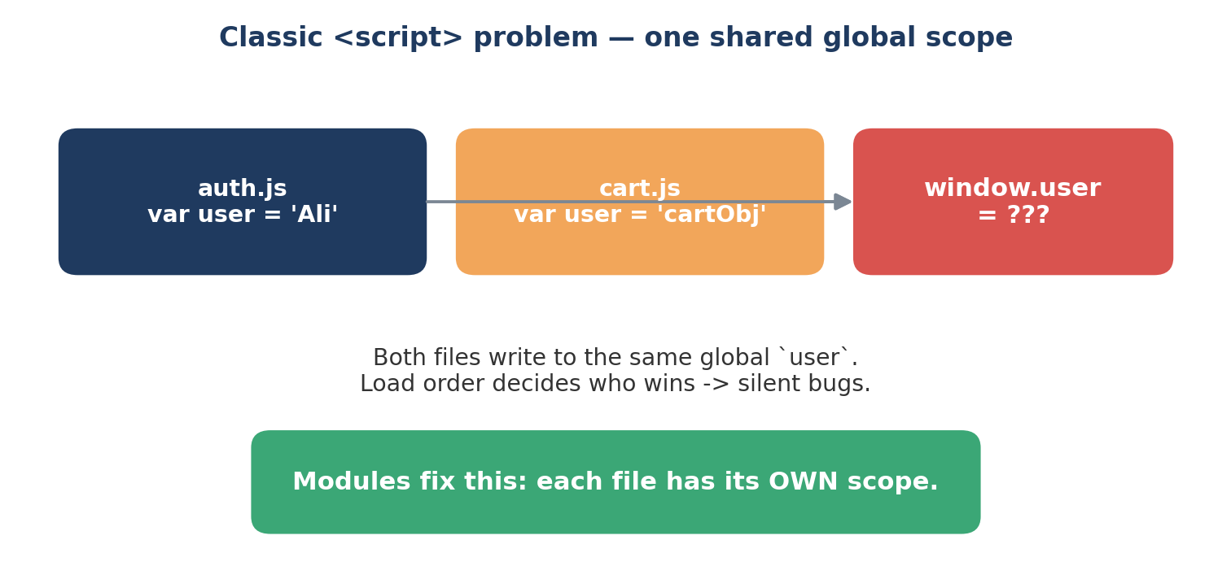
Day 6 — JavaScript Modules & Tooling: ES Modules, npm, Vite
Week 2 · Day 6
1. Life before modules — one giant global scope
Every <script> tag shared window. Variable collisions, load-order bugs, no privacy.
Modules give every file its OWN scope + an explicit "public API". This single idea fixes half the problems above.
MERN Stack Bootcamp · Instructor: Abid Ali
5 / 25

Slide 6
Day 6 — JavaScript Modules & Tooling: ES Modules, npm, Vite
Week 2 · Day 6
1. What a module buys you
• ISOLATION — variables inside a module are private by default.
• EXPLICIT DEPENDENCIES — you see exactly what a file needs at the top (`import …`).
• REUSABILITY — one module can be consumed by many files.
• TOOLING — bundlers, tree-shaking, linting and type-checking all need the module graph.
• ORDER-INDEPENDENCE — put <script type="module"> anywhere; imports are resolved for you.
MERN Stack Bootcamp · Instructor: Abid Ali
6 / 25

Slide 7
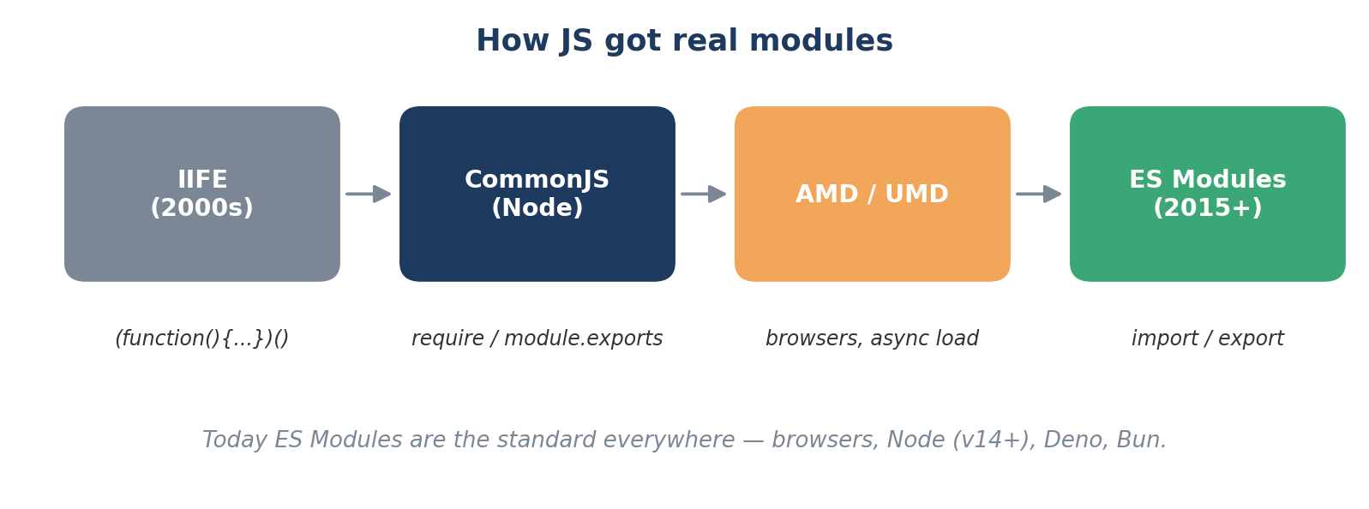
Day 6 — JavaScript Modules & Tooling: ES Modules, npm, Vite
Week 2 · Day 6
2. A short history of JS modules
• CommonJS (`require`) is still what Node originally shipped — you'll see it in legacy code.
• ES Modules are the standard — browser, Node, Deno, Bun all agree. Write this one.
MERN Stack Bootcamp · Instructor: Abid Ali
7 / 25

Slide 8
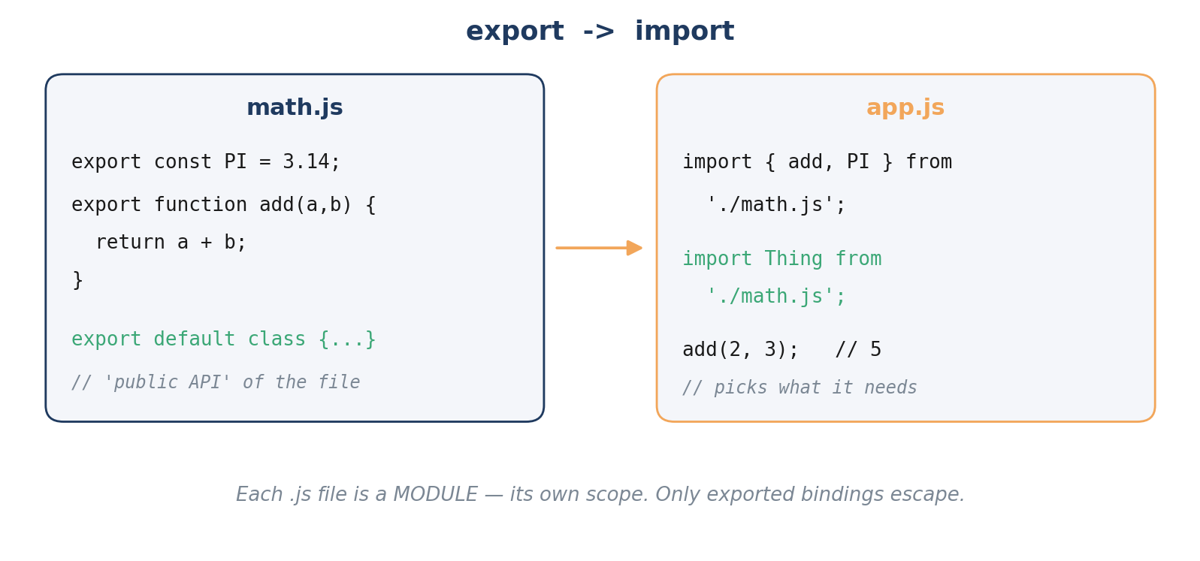
Day 6 — JavaScript Modules & Tooling: ES Modules, npm, Vite
Week 2 · Day 6
3. export — publishing your public API
Anything NOT exported is private to the module. That is the whole point.
MERN Stack Bootcamp · Instructor: Abid Ali
8 / 25

Slide 9
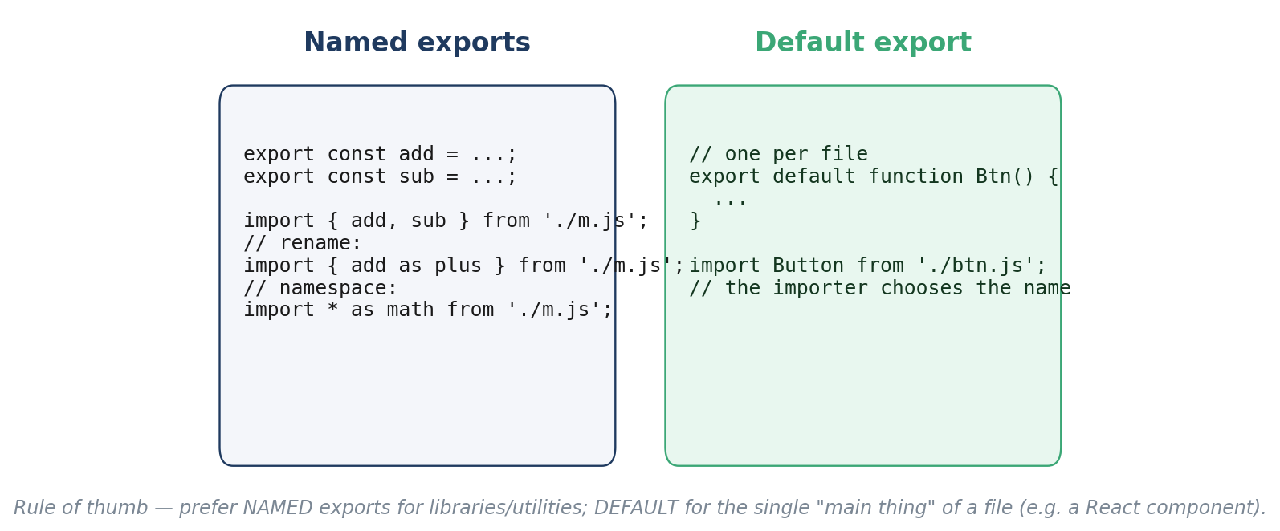
Day 6 — JavaScript Modules & Tooling: ES Modules, npm, Vite
Week 2 · Day 6
3. Named vs default exports
Rule: prefer NAMED exports. They auto-complete, they refactor safely, and grep finds usages. Use default only when a file exports ONE obvious thing.
MERN Stack Bootcamp · Instructor: Abid Ali
9 / 25

Slide 10
Day 6 — JavaScript Modules & Tooling: ES Modules, npm, Vite
Week 2 · Day 6
3. Every flavour of export, in one slide
// 1. Inline named export
export const PI = 3.14159;
export function add(a, b) { return a + b; }
// 2. Grouped named export
const sub = (a, b) => a - b;
const mul = (a, b) => a * b;
export { sub, mul };
// 3. Rename on the way out
export { mul as multiply };
// 4. Default export (one per file)
export default class Calculator { /* ... */ }
// 5. Re-export (barrel file)
export { add, sub } from './math.js';
export * from './trig.js';
MERN Stack Bootcamp · Instructor: Abid Ali
10 / 25

Slide 11
Day 6 — JavaScript Modules & Tooling: ES Modules, npm, Vite
Week 2 · Day 6
4. Every flavour of import
// 1. Named import
import { add, PI } from './math.js';
// 2. Rename
import { add as plus } from './math.js';
// 3. Default import (importer picks the name)
import Calc from './calc.js';
// 4. Mix default + named
import Calc, { PI } from './calc.js';
// 5. Namespace import (everything as one object)
import * as math from './math.js';
math.add(2, 3);
// 6. Side-effect only (runs the file, imports nothing)
import './style.css';
// 7. Dynamic (lazy) import -> returns a Promise
const mod = await import('./heavy.js');
MERN Stack Bootcamp · Instructor: Abid Ali
11 / 25

Slide 12
Day 6 — JavaScript Modules & Tooling: ES Modules, npm, Vite
Week 2 · Day 6
4. Import rules you must internalise
• Imports are HOISTED — they run before any code in the file.
• Imports are LIVE BINDINGS — you import a reference, not a copy.
• Imports are READ-ONLY — you cannot reassign an imported value.
• Every module is evaluated ONCE and cached — importing the same file twice gives you the same object.
• In real browsers, paths must be full (`./math.js` not `./math`). Bundlers relax that for you.
MERN Stack Bootcamp · Instructor: Abid Ali
12 / 25

Slide 13
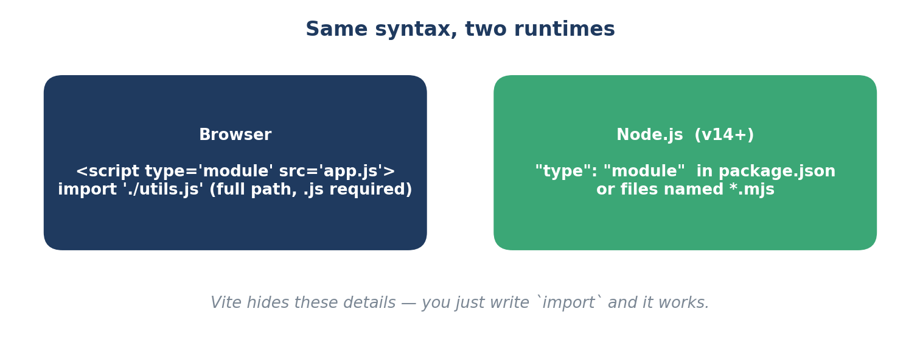
Day 6 — JavaScript Modules & Tooling: ES Modules, npm, Vite
Week 2 · Day 6
5. Where does `./math.js` actually come from?
• Relative path ./x.js — file next to me.
• Absolute path /x.js — from the web root.
• Bare specifier lodash — means "look in node_modules" (only bundlers / Node understand this).
MERN Stack Bootcamp · Instructor: Abid Ali
13 / 25

Slide 14
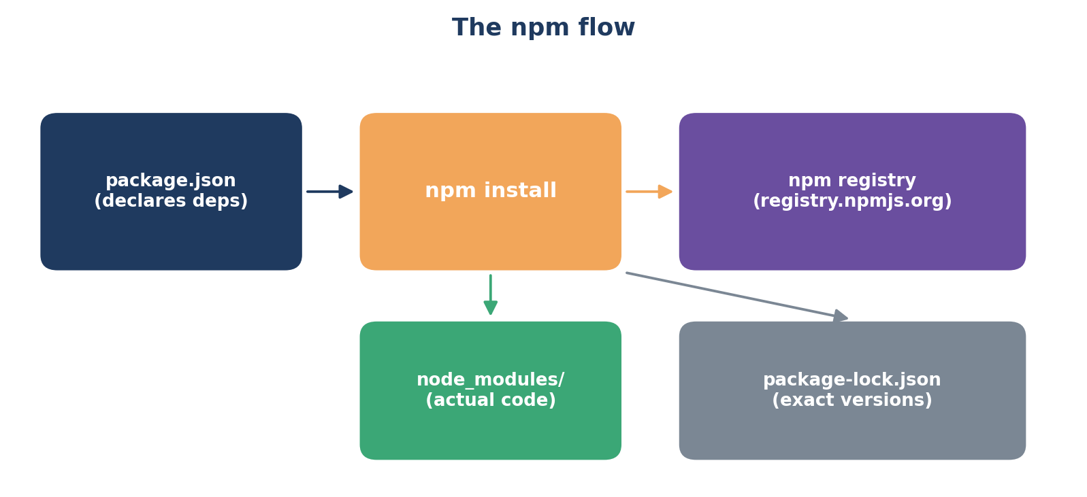
Day 6 — JavaScript Modules & Tooling: ES Modules, npm, Vite
Week 2 · Day 6
6. npm — Node Package Manager
Three files define any JS project: package.json (what you want), package-lock.json (what you actually got), node_modules/ (the actual code).
MERN Stack Bootcamp · Instructor: Abid Ali
14 / 25

Slide 15
Day 6 — JavaScript Modules & Tooling: ES Modules, npm, Vite
Week 2 · Day 6
6. package.json anatomy
{
"name": "my-app",
"version": "1.0.0",
"type": "module", // use ES Modules
"scripts": {
"dev": "vite",
"build": "vite build",
"preview": "vite preview"
},
"dependencies": { // needed at runtime
"dayjs": "^1.11.10"
},
"devDependencies": { // dev only (build/test/lint)
"vite": "^5.0.0"
}
}
MERN Stack Bootcamp · Instructor: Abid Ali
15 / 25

Slide 16
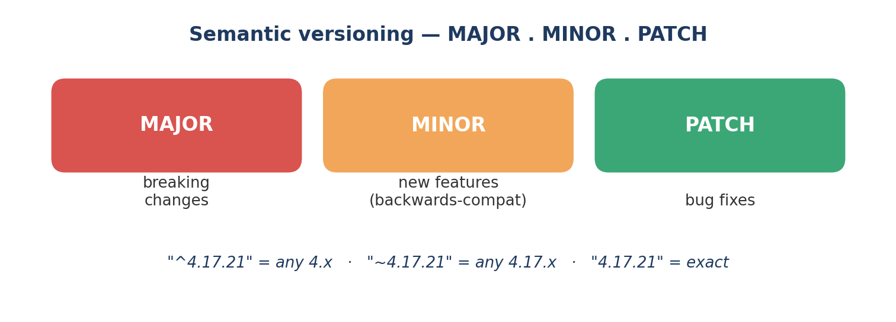
Day 6 — JavaScript Modules & Tooling: ES Modules, npm, Vite
Week 2 · Day 6
6. Semver — what ^ and ~ really mean
• ^1.4.2 → any 1.x.x that is ≥ 1.4.2 (flexible on minor+patch).
• ~1.4.2 → any 1.4.x that is ≥ 1.4.2 (only patch).
• 1.4.2 → exactly 1.4.2.
• package-lock.json LOCKS the exact version installed, so the build is reproducible for everyone.
MERN Stack Bootcamp · Instructor: Abid Ali
16 / 25

Slide 17
Day 6 — JavaScript Modules & Tooling: ES Modules, npm, Vite
Week 2 · Day 6
6. Everyday npm commands
# create a new project (y = accept all defaults)
npm init -y
# runtime dep
npm install dayjs
# dev-only dep
npm install --save-dev vite
# install everything listed in package.json
npm install
# run a script
npm run dev # runs the "dev" entry in scripts
# remove, update, audit
npm uninstall lodash
npm update
npm audit # check for known CVEs
# one-shot: run a CLI without installing
npx create-vite@latest my-app -- --template vanilla
MERN Stack Bootcamp · Instructor: Abid Ali
17 / 25

Slide 18
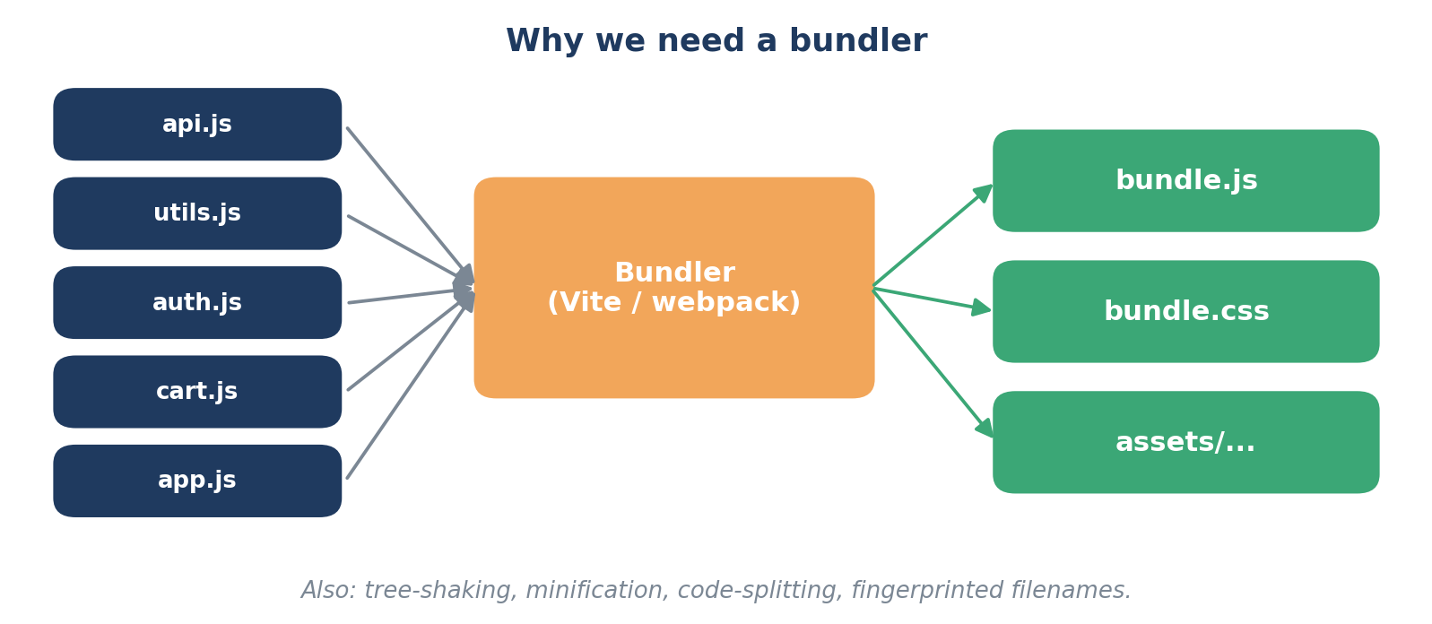
Day 6 — JavaScript Modules & Tooling: ES Modules, npm, Vite
Week 2 · Day 6
7. Browsers CAN run modules — so why bundlers?
• Raw ES Modules in a browser = many HTTP requests + slow cold starts on big apps.
• Bundlers give us tree-shaking, minification, code-splitting, env variables, CSS/image imports, TypeScript — the works.
MERN Stack Bootcamp · Instructor: Abid Ali
18 / 25

Slide 19
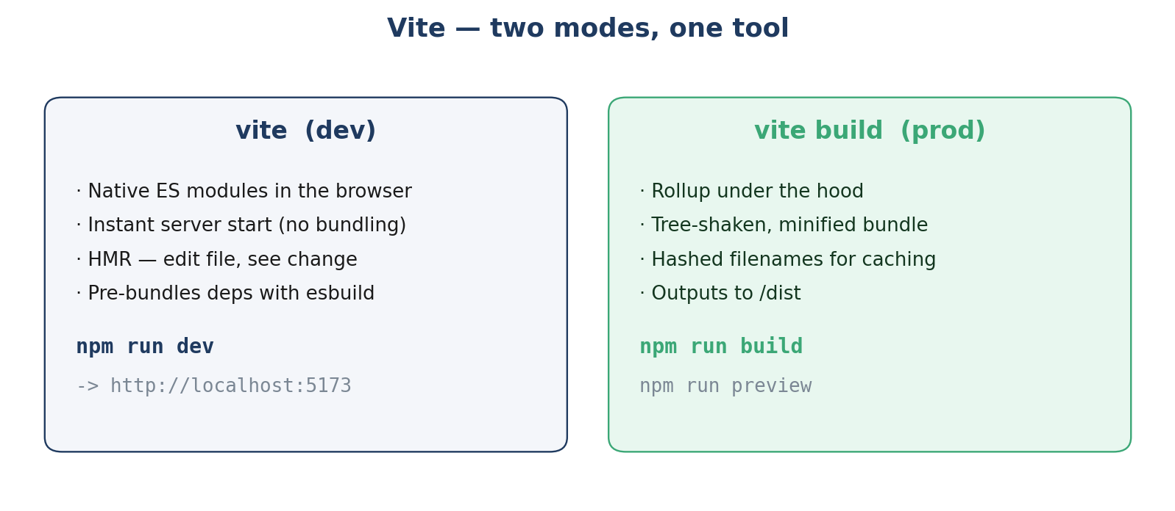
Day 6 — JavaScript Modules & Tooling: ES Modules, npm, Vite
Week 2 · Day 6
8. Vite — the modern build tool we will use
• Created by Evan You (Vue author), now the default for React, Vue, Svelte, SolidJS.
• Two modes: blazingly fast dev server, and a production build powered by Rollup.
• Zero-config for vanilla JS — just `npm create vite@latest`.
MERN Stack Bootcamp · Instructor: Abid Ali
19 / 25

Slide 20
Day 6 — JavaScript Modules & Tooling: ES Modules, npm, Vite
Week 2 · Day 6
8. Creating a Vite project — 30 seconds
# scaffold
npm create vite@latest my-app
# -> pick "Vanilla" -> "JavaScript"
cd my-app
npm install # pulls vite + deps into node_modules
npm run dev # http://localhost:5173 (HMR enabled)
# when you are ready to ship
npm run build # outputs /dist
npm run preview # serves /dist locally to sanity-check
HMR = Hot Module Replacement. Save a file — the browser updates WITHOUT losing your page state. This is the single biggest productivity win of modern tooling.
MERN Stack Bootcamp · Instructor: Abid Ali
20 / 25

Slide 21
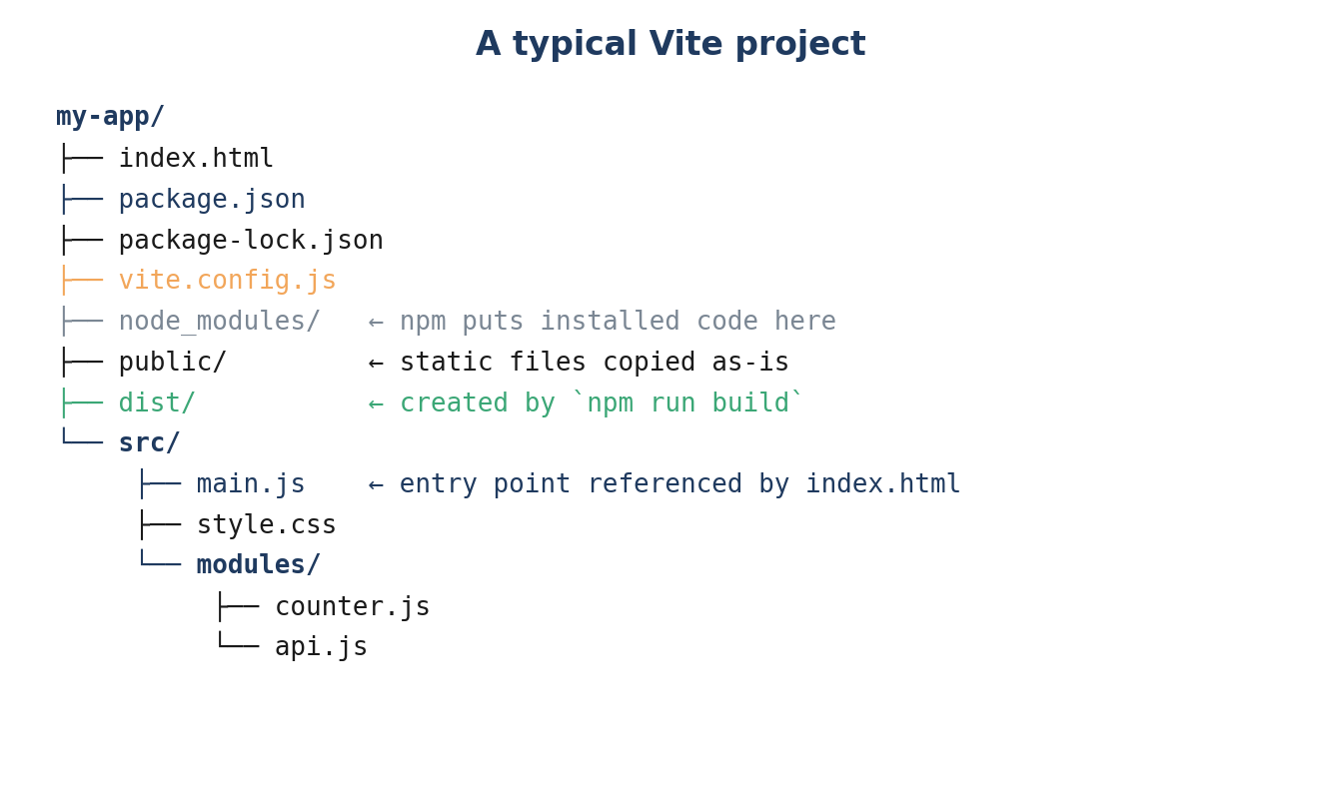
Day 6 — JavaScript Modules & Tooling: ES Modules, npm, Vite
Week 2 · Day 6
8. What Vite sets up for you
MERN Stack Bootcamp · Instructor: Abid Ali
21 / 25

Slide 22
Day 6 — JavaScript Modules & Tooling: ES Modules, npm, Vite
Week 2 · Day 6
8. index.html is the entry point
<!-- index.html -->
<!doctype html>
<html>
<body>
<div id="app"></div>
<script type="module" src="/src/main.js"></script>
</body>
</html>
// src/main.js
import './style.css';
import { Counter } from './modules/counter.js';
const app = document.getElementById('app');
app.innerHTML = `<button id="btn">0</button>`;
new Counter(document.getElementById('btn'));
MERN Stack Bootcamp · Instructor: Abid Ali
22 / 25

Slide 23
Day 6 — JavaScript Modules & Tooling: ES Modules, npm, Vite
Week 2 · Day 6
9. Pitfalls you will hit this week
• Opening index.html by double-clicking (file://) — ES Modules refuse to load. ALWAYS use `npm run dev`.
• Forgetting the `.js` extension in a relative import in the browser — works under Vite, breaks in pure browser/Node.
• Mixing `require()` and `import` in the same file — pick one.
• Committing `node_modules/` to git — DON'T. Commit package-lock.json instead.
• Running a script you don't recognise — `npm run` with no args lists every defined script.
• `npm audit` warnings are normal — review, don't panic.
MERN Stack Bootcamp · Instructor: Abid Ali
23 / 25

Slide 24
Day 6 — JavaScript Modules & Tooling: ES Modules, npm, Vite
Week 2 · Day 6
Cheat-sheet — one image, pin it on your monitor
What you want | How to say it
Export one thing + others | export default X; export const Y = ...;
Import the default | import X from './m.js'
Import named things | import { a, b } from './m.js'
Rename an import | import { a as plus } from './m.js'
Import everything | import * as m from './m.js'
Lazy import | const m = await import('./m.js')
Create a project | npm create vite@latest my-app
Install a runtime dep | npm install dayjs
Install a dev tool | npm install -D vite
Run dev server | npm run dev
Production build | npm run build
Reproducible install | npm ci (CI / new machine)
MERN Stack Bootcamp · Instructor: Abid Ali
24 / 25

Slide 25
Time to scaffold a real project
Open the lab manual — you'll build a tiny multi-module app with Vite, install an npm package, and ship a production build.
Lab file:
LAB MANUAL DAY 6 - MODULES AND VITE.pdf
Coming next: the DOM + real UI building — with everything you learned today as the foundation.
Instructor: Abid Ali · MERN Stack Bootcamp · Week 2 · Day 6

